Slide 1





Training
9.
1. Training dataset is uploaded to Object Storage bucket for raw training data using OIC on a schedule. Bucket name: Training, object name: YYYY-mm-dd-HH-MM-SS-petname
1.
Object Storage
Autonomous Data Warehouse
2. On a scheduled basis (e.g. weekly), a request is made to invoke a DS Job Run VM from a DS Job using OCI-DI.
Data source
Integration Cloud
3.
3. DS Job Run contains an artifact that seeks the most recently uploaded object in the Training bucket. This object is imported to the DS Job Run VM.
4.
4. Raw dataset is processed using AutoML feature selection.
5.
5. Processed version of training dataset is sent to ADW under schema “Proc_Training” under table named same as object name
6.
Data Science Job
6. Model is trained using processed dataset and AutoML algorithm selection
2.
7. Model is submitted to DS Model Catalog names same as object name
8. From DS Job Run, DS Model Deployment VM is provisioned using most recent DS Model Catalog entry, named same as object name
Data Integration
Data Science Job Run
7.
8.
Data Science Model Deployment
9. Old objects are moved to Archive storage tier by Lifecycle Policy Rule (or event-driven, upon completion of previous step)
Data Science Model Catalog

Slide 2



Inferencing
8.
1. Inference dataset is uploaded to Object Storage bucket for raw training data using OIC on a schedule. Bucket name: Inference, object name: YYYY-mm-dd-HH-MM-SS-petname
1.
7.
Object Storage
Analytics
Autonomous Data Warehouse
2. Upon object_update or object_create, an Events Rule is matched, and a Function is triggered, which invokes a DS Job Run VM from a DS Job using OCI-DI.
Data source
Integration Cloud
3.
3. DS Job Run contains an artifact that seeks the most recently uploaded object in the Inference bucket. This object is imported to the DS Job Run VM.
6.
4.
4. Raw dataset is processed using AutoML feature selection.
5. Processed dataset is inferenced by the DS Model Deployment with the same as the object, to generate a prediction table
Events
5.
6. From DS Job Run, the prediction table is sent to ADW under schema “Prediction” under table named same as object name
Data Science Job
2.
7. An OAC representation of the prediction table is updated from the source in ADW on an hourly basis, and data visualizations that use this dataset are updated as a result.
Functions
Data Science Job Run
Data Science Model Deployment
8. Old objects are moved to Archive storage tier by Lifecycle Policy Rule (or event-driven, upon completion of previous step)

Slide 3





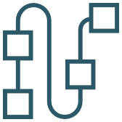
























OCI Icons
Governance
Observability and Management
Oracle Cloud Identifier
Compartments
Policies
Groups
Queuing
Workflow
Notifications
Search
Email Delivery
Resource
Manager
Logging
Auditing
Tagging
User
Healthcheck
Events
Monitoring
Alarms
VCN Flow Logs
Marketplace
Security
Service Connector Hub
API Services
DDoS Protection
WAF
Cloud Guard
Key Vault
Encryption
Key Management
Maximum
Security Zone
IAM
API Gateway
API Service

Slide 4
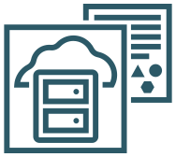
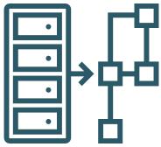




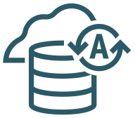














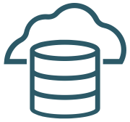
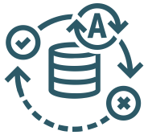

OCI Icons
Data management
Storage
Analytics
Data Catalog
Database
Migration
Streaming
Block Storage
Object Storage
Analytics Cloud Service
Oracle Machine Learning
Artificial Intelligence
Data Science
Data
Integration
Autonomous Data Warehouse Cloud Service
Autonomous Database
Buckets
Back Up/
Restore
Low Code
Other
Data Transfer
Other Cloud Service
MySQL Database Service
Exadata Cloud
Data Flow
Block Storage Cloning
APEX
Database System
Autonomous Data Warehouse
Big Data
Elastic
Performance
Storage Gateway
No SQL Database
Database Cloud
Service
Autonomous Transaction Processing ATP
File Storage

